Slide 1
EM and Mixture models
Huijun Di
ajon@bit.edu.cn

Slide 2
Expectation Maximization (EM)
What is it? How does it work?
Introduction, Motivation, and Intuition
When would you use it?
Applications
Why does it work?
Theory
How do you implement it?
Practical issues, and Cooooooding
Where does it stand in relation to other methods?
Comparison with other methods

Slide 3
Outline
Introduction, Motivation and Intuition
Applications
Theory
Practical issues, and Coding
Comparison with other methods

Slide 4
Expectation Maximization (EM)
Iterative method for parameter estimation
where you have missing data
Has two steps
Expectation (E) and Maximization (M)
Applicable to a wide range of problems
Old idea (late 50’s)
but formalized by Dempster, Laird and Rubin in 1977
Subject of much investigation
See book “The EM Algorithm and Extensions” by McLachlan & Krishnan

Slide 5



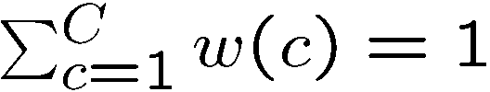





Motivating example
Data:
-4
-3
-2
-1
0
1
2
3
4
5
OBJECTIVE: Fit mixture of Gaussian model with C=2 components
Model:
where
Parameters:
P(x|θ)
keep
fixed
i.e. only estimate
x

Slide 6
Intuition of EM
E-step: Compute a distribution on the labels of the points, using current parameters
M-step: Update parameters using current guess of label distribution.
E
M
E
M
E

Slide 7
Outline
Introduction, Motivation and Intuition
Applications
Theory
Practical issues, and Coding
Comparison with other methods

Slide 8
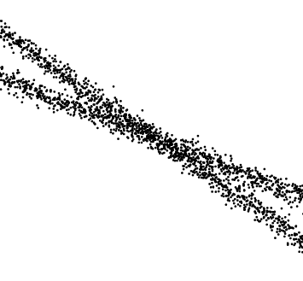
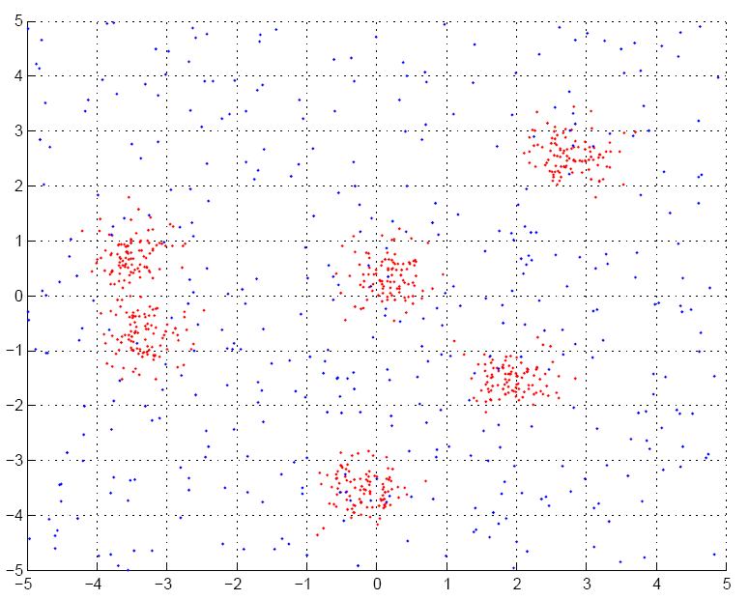
Applications of EM (1)
Fitting mixture models

Slide 9








Applications of EM (2)
Image Segmentation

Slide 10
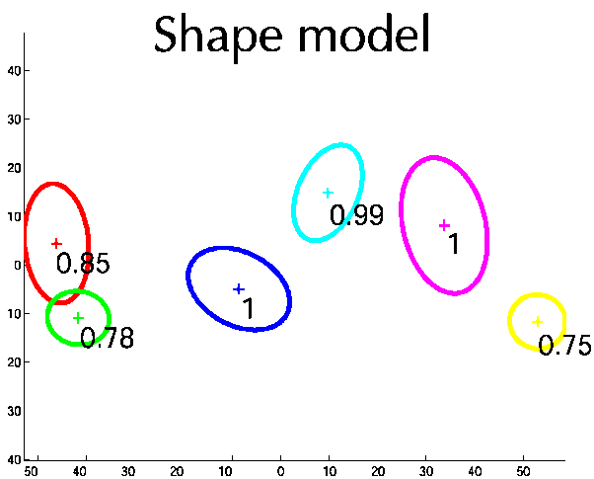
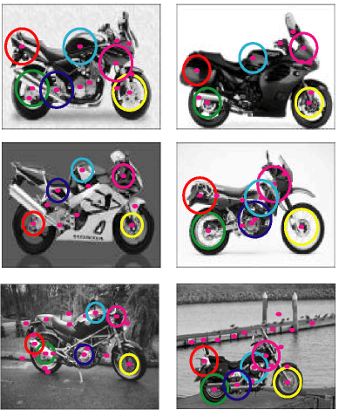
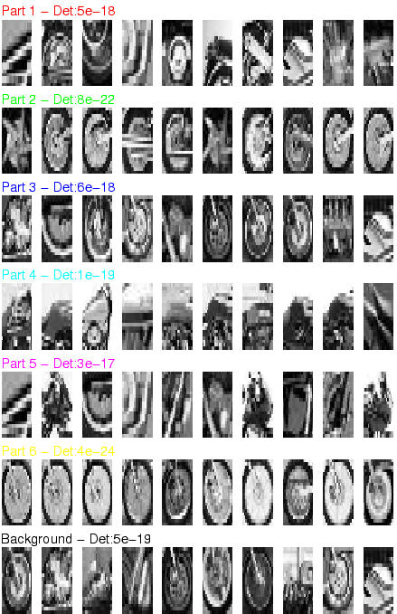
Applications of EM (3)
Learning parts and structure models

Slide 11
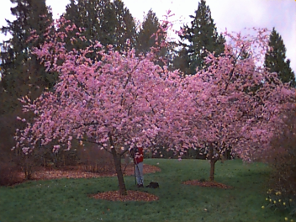

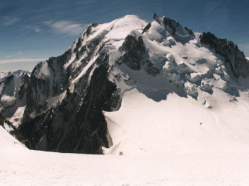

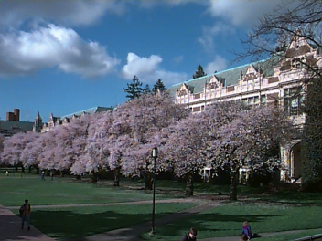


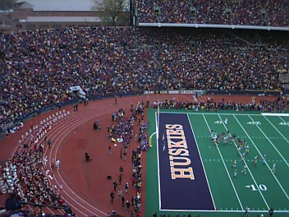
Applications of EM (4)
Object Class Recognition in CBIR
Known: Some images and their corresponding descriptions
•••
{trees, grass, cherry trees}
{cheetah, trunk}
{mountains, sky}
{beach, sky, trees, water}
To solve: What object classes are present in new images
•••
?
?
?
?

Slide 12
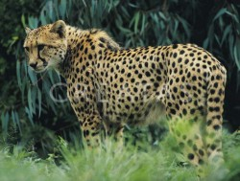





Tree
Sky
Initial Model for “trees”
Final Model for “trees”
EM
Initial Model for “sky”
Final Model for “sky”

Slide 13
Outline
Introduction, Motivation and Intuition
Applications
Theory
Practical issues, and Coding
Comparison with other methods

Slide 14
Motivating example
Data:
-4
-3
-2
-1
0
1
2
3
4
5
OBJECTIVE: Fit mixture of Gaussian model with C=2 components
Model:
where
Parameters:
P(x|θ)
keep
fixed
i.e. only estimate
x

Slide 15
Intuition of EM
Is it correct?
E-step: Compute a distribution on the labels of the points, using current parameters
M-step: Update parameters using current guess of label distribution.
E
M
E
M
E

Slide 16
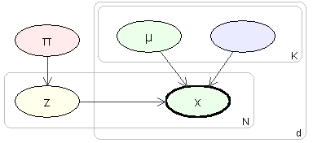
Probabilistic model
Imagine model generating data
Need to introduce label, z, for each data point
Label is called a latent variable
also called hidden, unobserved, missing
σ
c
-4
-3
-2
-1
0
1
2
3
4
5
Simplifies the problem:
if we knew the labels, we can decouple the components as estimate parameters separately for each one

Slide 17
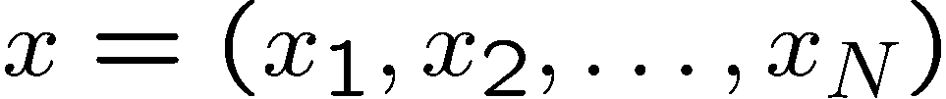
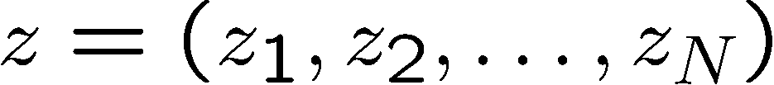

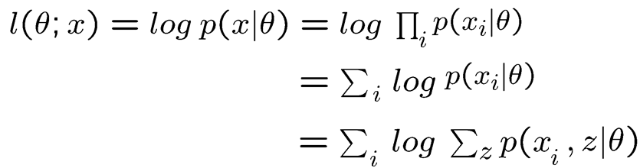
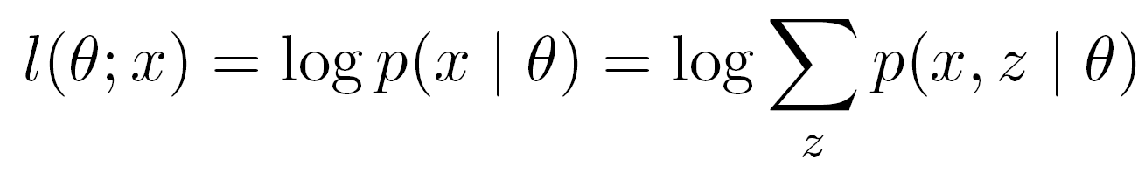
Some definitions
Observed data
Continuous I.I.D
Latent variables
Discrete 1 ... C
Iteration index
Log-likelihood [Incomplete log-likelihood (ILL)]

Slide 18
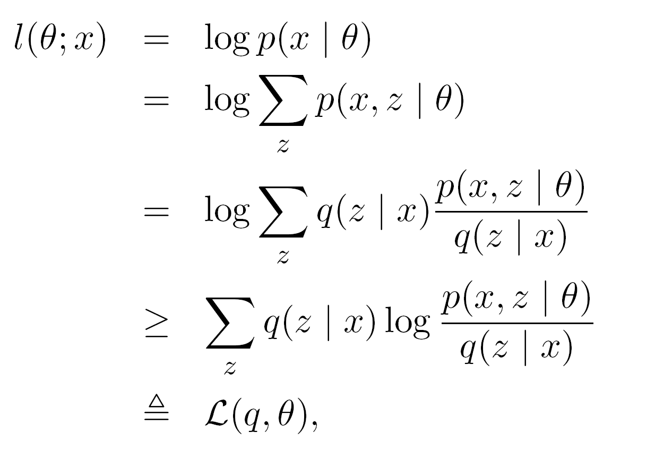
Lower bound on log-likelihood
Use Jensen’s
inequality
AUXILIARY FUNCTION

Slide 19
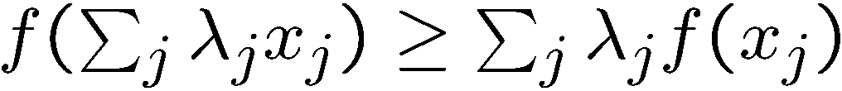




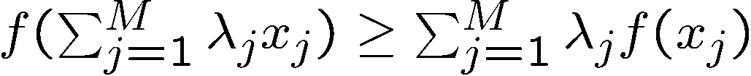













Jensen’s Inequality
Jensen’s inequality:
For a real continuous concave function
and
1. Definition of concavity. Consider
where
then
2. By induction:
for
Equality holds when all x are the same
2. Consider a set of points, , lying in the interval
and
such that
and
then
lies in

Slide 20

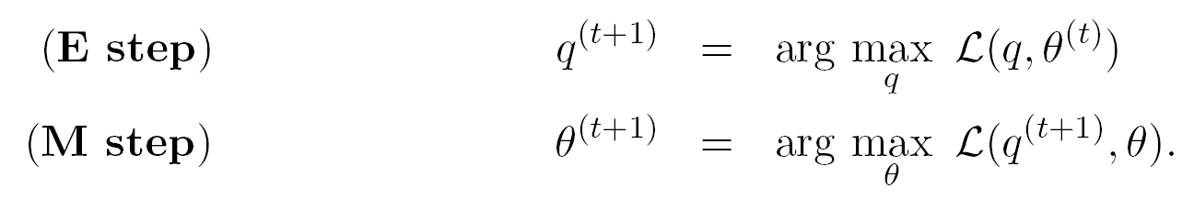
EM is alternating ascent
Recall key result : Auxiliary function is LOWER BOUND on likelihood
Alternately improve q then θ:
Is guaranteed to improve likelihood itself….

Slide 21
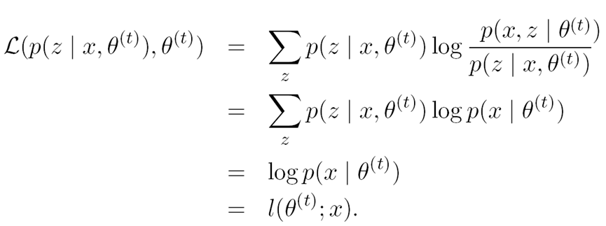
E-step: Choosing the optimal q(z|x,θ)
Turns out that q(z|x,θ) = p(z|x,θ^{t}) is the best.

Slide 22
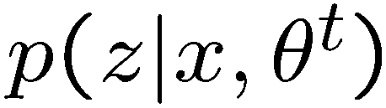

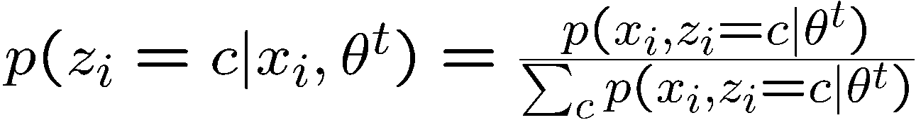
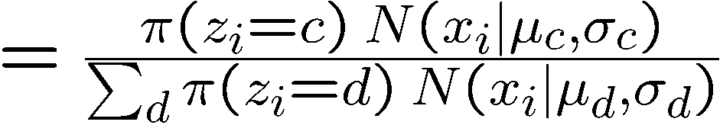
E-step: What do we actually compute?
Point 1
Point 2
Point 6
nComponents x nPoints matrix (columns sum to 1):
Component 1
Component 2
Responsibility of component for point :

Slide 23
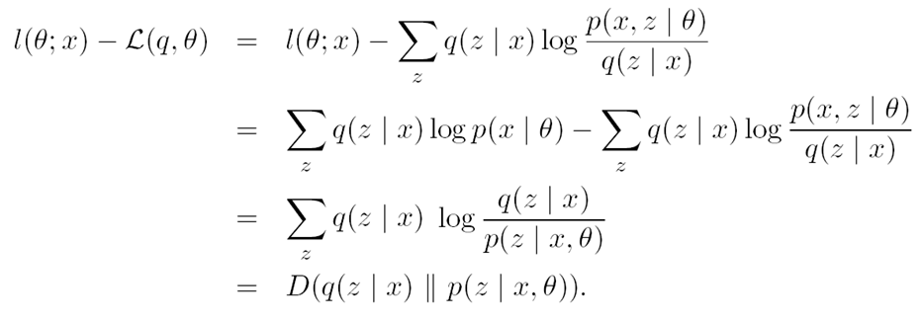
E-step: Alternative derivation

Slide 24
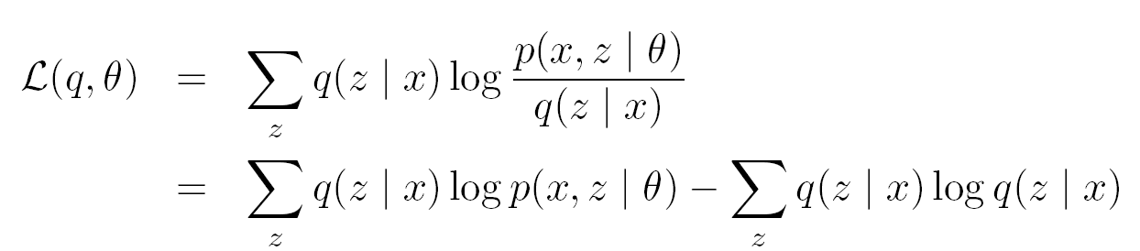
M-Step
Auxiliary function separates into ECLL and entropy term:
Expected complete log-likelihood (ECLL)
Entropy term

Slide 25
Outline
Introduction, Motivation and Intuition
Applications
Theory
Practical issues, and Coding
Comparison with other methods

Slide 26
Let’s practice and coooding
Multiple Line Fitting

Slide 27
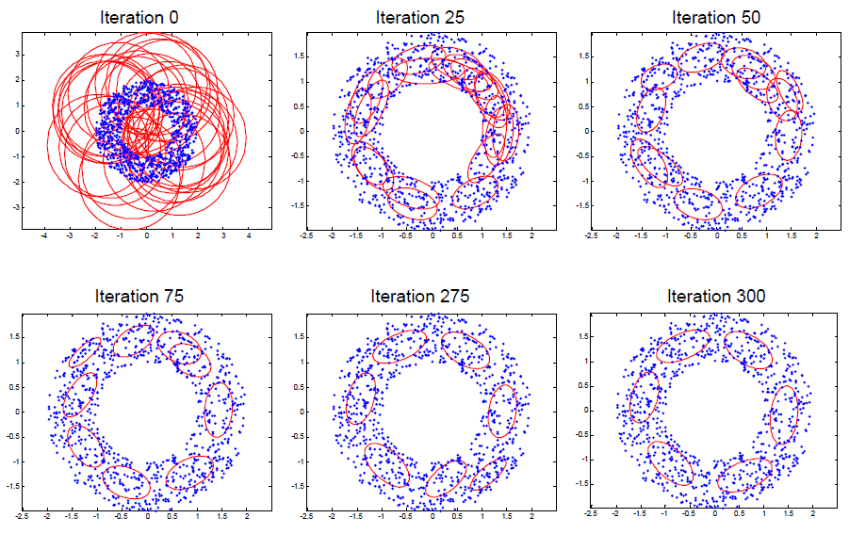
EM for Gaussian Mixtures

Slide 28
Practical issues
Initialization
Mean of data + random offset
K-Means
Termination
Max # iterations
log-likelihood change
parameter change
Convergence
Local maxima
Annealed methods
Number of components
Open problem
Minimum description length
Bayesian approach

Slide 29
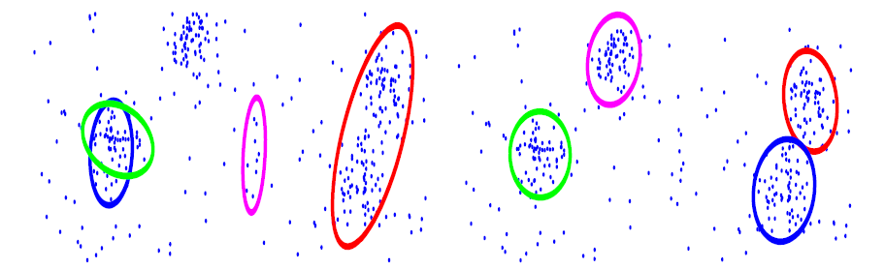
Local minima

Slide 30
Outline
Introduction, Motivation and Intuition
Applications
Theory
Practical issues, and Coding
Comparison with other methods

Slide 31
Why not use standard optimization methods?
In favour of EM:
No step size
Works directly in parameter space model, thus parameter constraints are obeyed
Fits naturally into graphically model frame work
Supposedly faster

Slide 32
Motivating example
Data:
-4
-3
-2
-1
0
1
2
3
4
5
OBJECTIVE: Fit mixture of Gaussian model with C=2 components
Model:
where
Parameters:
P(x|θ)
keep
fixed
i.e. only estimate
x

Slide 33
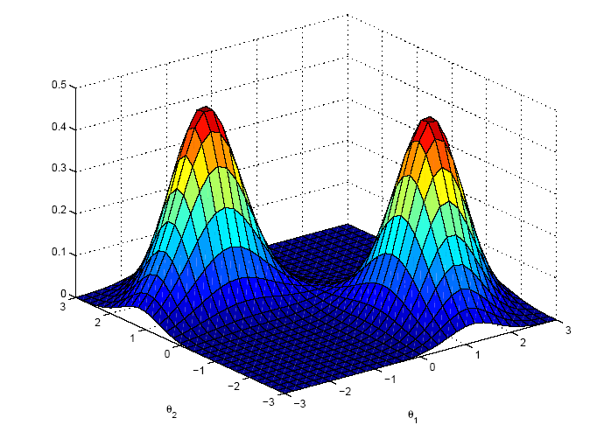

Likelihood function
Likelihood is a function of parameters, θ Probability is a function of r.v. x

Slide 34
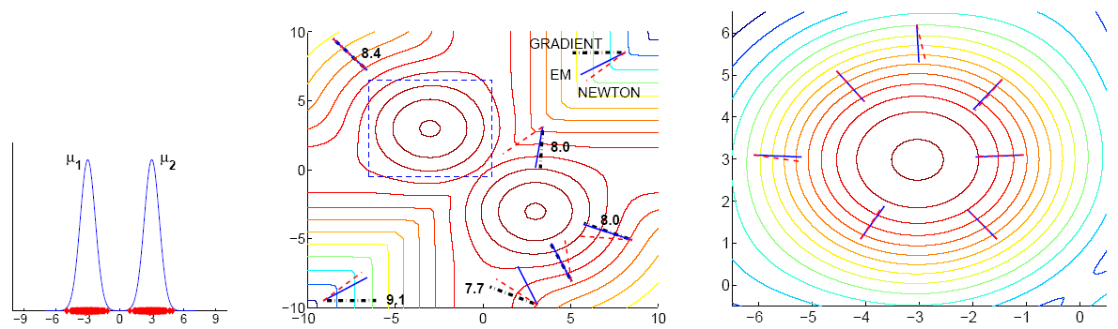
Gradient
Newton
EM

Slide 35
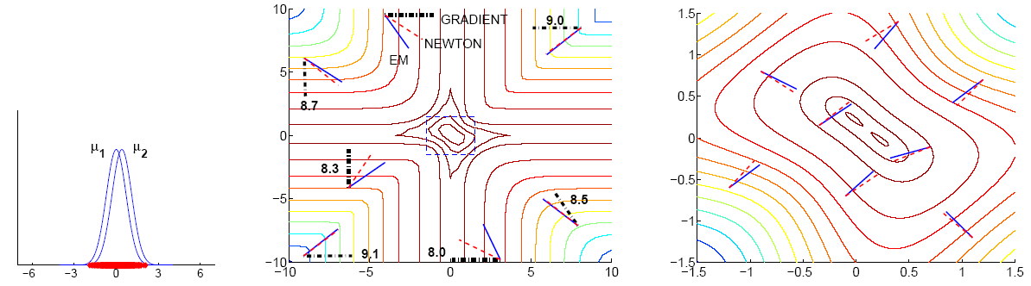
Gradient
Newton
EM

Slide 36
End

